Slide 1
Pima Community College Camera Team Jared Guglielmo and Stephen Yanez
21th Annual Arizona Space Grant Symposium
April 21, 2012
University of Arizona

Slide 2
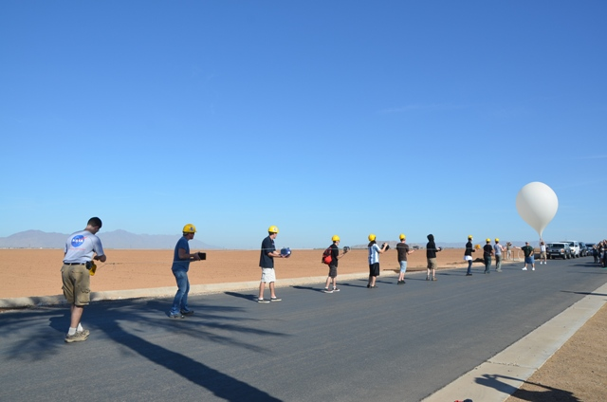
Flight information
Date of flight: March 31, 2012
Time of Launch: 09:01:01 MST
Location: Maricopa Agricultural Center, Maricopa Arizona
Us!

Slide 3
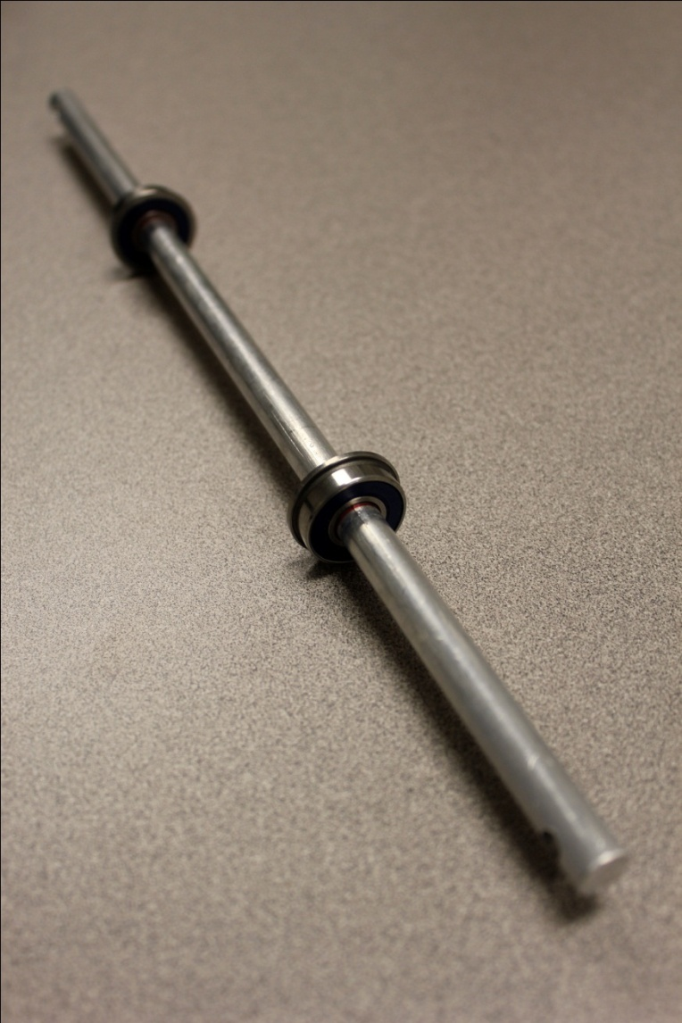
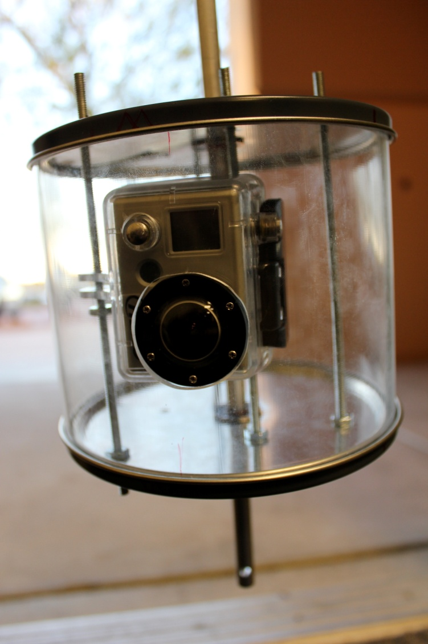
Camera Payload Design
bearings
axle
attachment point
GoPro camera

Slide 4
Objectives
Minimize payload rotation to provide better video
Design a more aerodynamic payload than previous models
Isolate our payload from as many forces as possible to help with minimizing rotation

Slide 5
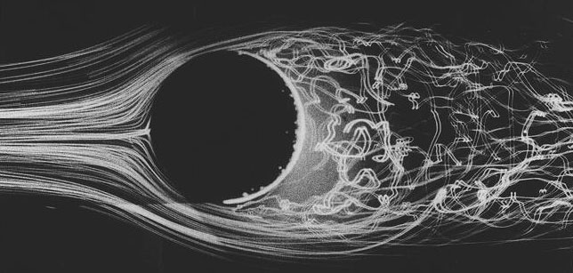
Video Camera Payload
Problem:
Reduce excessive rotation of payload during flight
Proposed solution:
Change shape of payload from rectangular to cylindrical
Reasoning:
Research results demonstrate that the airflow flow pattern around a cylinder are significantly different than that around a rectangle
© 2011 SAGE ACTION, Inc. http://www.sageaction.com/Cylinder1.html
Winds of the City ©2004, 2005 Keith C. Heidorn, PhD
http://www.islandnet.com/~see/weather/elements/citywind.htm

Slide 6
Results
Approximate Altitude: 1500 ft-2500ft
http://www.youtube.com/watch?v=LWvTg-gyDTc&context=C46a9b1aADvjVQa1PpcFOsWYkCGSRx7b5jcUf1ivBHrWStwTRgii4=

Slide 7
Approximate Altitude: 41200 ft. – 41600 ft.
http://www.youtube.com/watch?v=sYiu1KsdHR4&context=C4457516ADvjVQa1PpcFOsWYkCGSRx7cueEoIxYjeQqS9HAH55PkU=

Slide 8
Lessons learned and future plans
Increase testing and modeling
Optimize aerodynamics
Improve preflight accessibility
Minimize weight and size

Slide 9
Acknowledgements
Special thanks to the following:
Susan Brew and NASA Space Grant Consortium
Jack Crabtree and ANSR
Mike Sampogna, Pima Community College
Dr. Denise Meeks, Pima Community College
8

